Slide 1
How can users effectively interpret massive monitoring and analytics data?
Dr. Sofia Tsekeridou, sofia.tsekeridou@netcompany.com (presenter)
Filopoimin Lykokanellos, filopoimin.lykokanellos@netcompany.com
Evangelos Agorogiannis, evangelos.agorogiannis@netcompany.com

Slide 2
Innovation creates challenges …
On-field technology innovation during pre-hospital care and support facilitates First Responders in complex triage and rescue tasks in mass casualty incidents, and in continuously monitoring a victim on field, when time is available
It however results in massive data that needs to be effectively managed, processed/transformed and presented in intuitive ways to be easily and timely interpreted by users, supporting them effectively towards informed decisions, without overloading them with too much information
First responders, incident managers, Command and Control operators are already heavily tasked and under resourced in mass casualty incidents to be able to timely and effectively assess and interpret all these data themselves without support
Time in mass casualty incidents is of essence to save lives! Reliable and complete information as well to assess the situation and make time-critical decisions!
Information overload, when over-burdened with time-critical tasks, rather worsens decision making than helps make timely and informed critical decisions

Slide 3
… that boost further innovation!
Advancements in data integration and management systems to effectively and timely manage massive amounts of data from heterogeneous sources
Advancements in data interoperability and metadata standards to enable the unified representation of and interoperable access to all generated and used data
Advancements in time series and spatio-temporal data processing and analysis to:
Filter data from noise/outliers, manage missing data, etc.
Discover correlations and relationships, link data together
Produce quality and reliable data
Advancements in information visualization and visual analytics for optimal decision support
To reduce information overload and provide intuitive and informant information visualizations

Slide 4
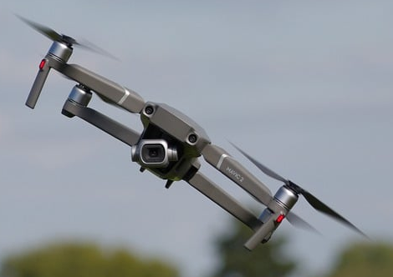
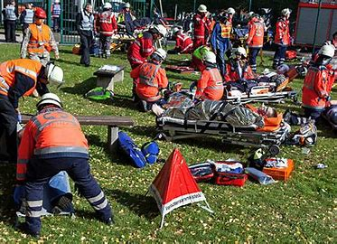
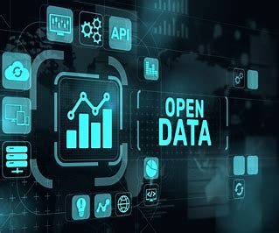
Field
Massive Live on field Data Streams
Heterogeneous Real-time Digital Data generated from:
Wearable medical sensors and devices
Drones with cameras
Thermal cameras
Triage and other mobile apps
Personal medical records, etc.
Heterogeneous Data Needed for optimal and timely Mass Casualty Incidents Management and Response
Closed Data in Situ
Closed Data in Situ :
Electronic Health Record Registries
Historical Data Sets from Past MCIs
FR internal organization data, etc.
Open Data Sources
Open Data Sources:
Weather Portals
Population data
Location-based traffic data
Open datasets for training, etc.

Slide 5
Command
& Control
Data-driven DSS tools
Resulting Data:
Warnings and alerts
Statistics and reports
Data correlations (spatio-temporal), linked data
Curated, filtered and pre-processed data
Annotated and harmonized data, etc.
AI-driven DSS tools
Data and AI-driven DSS tools and Command and Control Systems equally generate crucial near real-time data for MCIs
Resulting Data:
Warnings and Alerts
Predictions and forecasts
Trained models, etc.
AI
Command and Control Systems
Resulting Data:
Situational Awareness data
Resources, task assignments and status reports,
Validated alerts, etc.

Slide 6
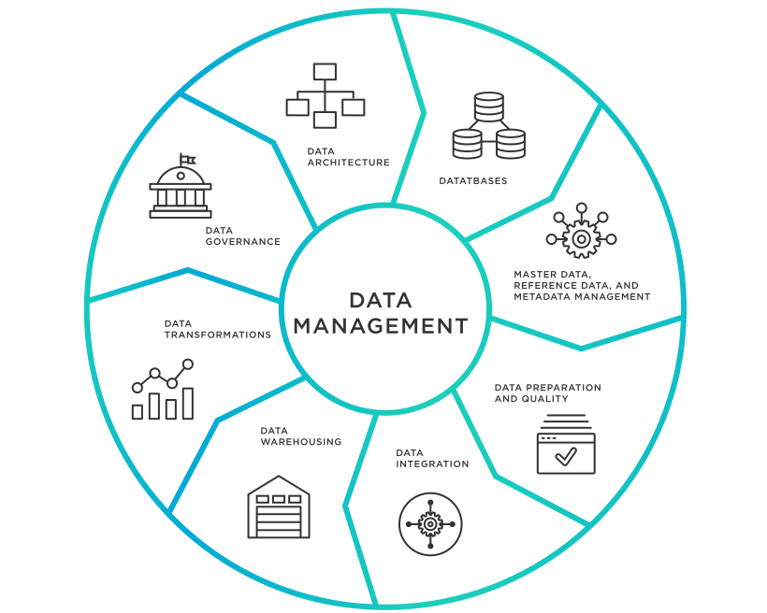
Field
Command
& Control
Data-driven DSS tools
Massive Live on field Data Streams
AI-driven DSS tools
Heterogeneous Data Needed for optimal and timely Mass Casualty Incidents Management and Response
Data and AI-driven DSS tools and Command and Control Systems equally generate crucial near real-time data for MCIs
AI
Closed Data in Situ
Command and Control Systems
Open Data Sources

Slide 7
Interoperable Data Lake (IDL)
DATA INTEROPERABILITY
Collects and integrates existing in situ or required open data
Aggregates, manages, stores and provides access to live triage and other data from on-field components (sensors, drones, apps, etc.) to be fed to other data and AI-driven components for decision support
Aggregates, manages and stores results and outputs from other Nightingale components (AI tools, DSS, Command and Control, etc.)
Provides Interactive Visualization Dashboards with customized aggregated information visualizations of different types per need and temporal instance
Provides a data-driven Decision Support System, which through an interactive frontend offers filtered and processed data visualizations and enables real-time alerting to Command and Control in case of abnormal monitored vitals trends and wearable vital signs sensors malfunctioning.
Ensures data interoperability in terms of unified, standards-based data descriptions and timely interoperable data access
It is used both during the management of an MCI and in post-MCI phase for aggregated statistics, reports and KPIs generation
DATA VISUALIZATION
DATA-DRIVEN DSS

Slide 8
New Operational Role: Data Officer
The Data Officer is a newly introduced operational role, that performs real-time information monitoring, data curation, situational awareness and early warnings. He/She is responsible for handling and evaluating the vast amount of time-series and spatio-temporal data generated by on field tools and crisis management systems, significantly supported by IDL, in order to reduce the information overload of other existing roles.
The Data Officer's key tasks include:
Evaluating Data: Assessing the data and vitals measurements gathered by on field smart devices and sensing elements to identify critical trends and anomalies in victim’s vitals: temperature, heart rate, respiratory rate, oxygen saturation, systolic and diastolic blood pressure.
Prioritizing Victims: Using the IDL interactive real-time information visualizations and decision support functions to prioritize victims based on their vital signs, ensuring those with critical health indicators are addressed promptly.
Sending Alerts: Making informed decisions to send alerts to the Command and Control System when a victim's health status deteriorates or when wearable vital signs sensors malfunction.

Slide 10
Interoperable Data Lake Innovations
IDL brings significant added value to operational procedures when massive amounts of data need to be handled, enhancing the efficiency and effectiveness of incident management.
Key innovations are:
Single point for heterogeneous data access, query and retrieval in interoperable manner
More Fine-Grained, Self-explaining Information Presentation and Comprehensive Visualizations for timely and informed decision support
Quicker Alerting during MCI and Reporting/Analysis after and MCI
Improved Alert Management
Scalability and Robustness under stress high data loads and stress conditions

Slide 11
What lies next
Introduce enhancements to mature IDL and customize it for use in diverse health emergencies use contexts. Among these enhancements, the following are considered:
User Interface Enhancements: to increase in close collaboration with end users its intuitiveness and usability
Advanced Data/Visual Analytics: to devise further advanced data and visual analytics and machine learning algorithms to provide a diverse set of insights and semi-automated decision support
Integration with Additional Systems: to develop further integration capabilities to more external systems and data sources, enhancing interoperability, and adopting further relevant standards.
Detailed after-incident reporting with measured quantitative KPIs: to improve the reporting capabilities of IDL for after-incident evaluation, including the automated measurement of relevant quantitative KPIs.
Such activities have started in the context of the Horizon Europe ESCORT project (https://www.escortproject.eu/ ) – AI-enabled healthcare for cross-border medical emergencies and routine patient care.

Slide 12
Dr. Sofia Tsekeridou: sofia.tsekeridou@netcompany.com (presenter) Filopoimin Lykokanellos: filopoimin.lykokanellos@netcompany.com Evangelos Agorogiannis: evangelos.agorogiannis@netcompany.com
Thank you!

