Slide 1
Welcome and introduction of NIGHTINGALE Final Event
Dr. Angelos Amditis – ICCS
Coordinator

Slide 2
Presentation Contents
NIGHTINGALE project at a glance
NIGHTINGALE objectives and pilotss
Final Event Agenda
Notes:
Presentation Contents

Slide 3
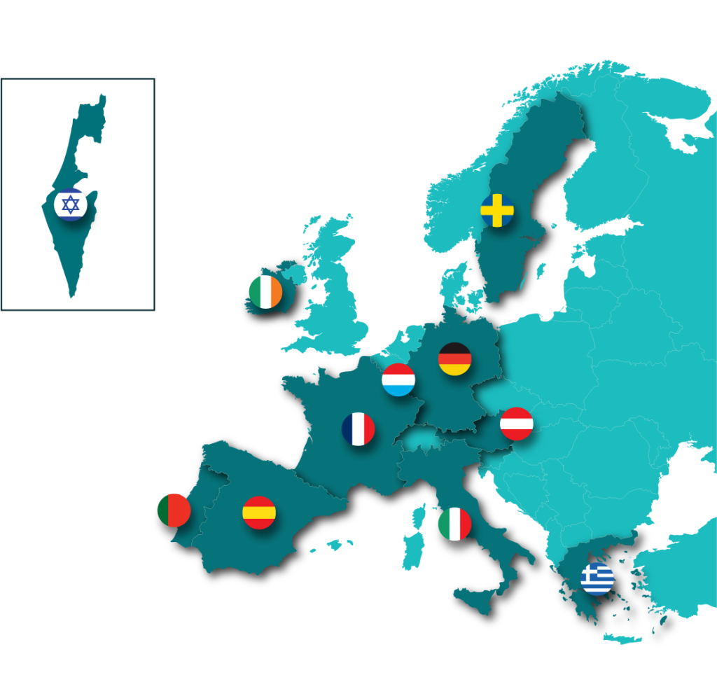
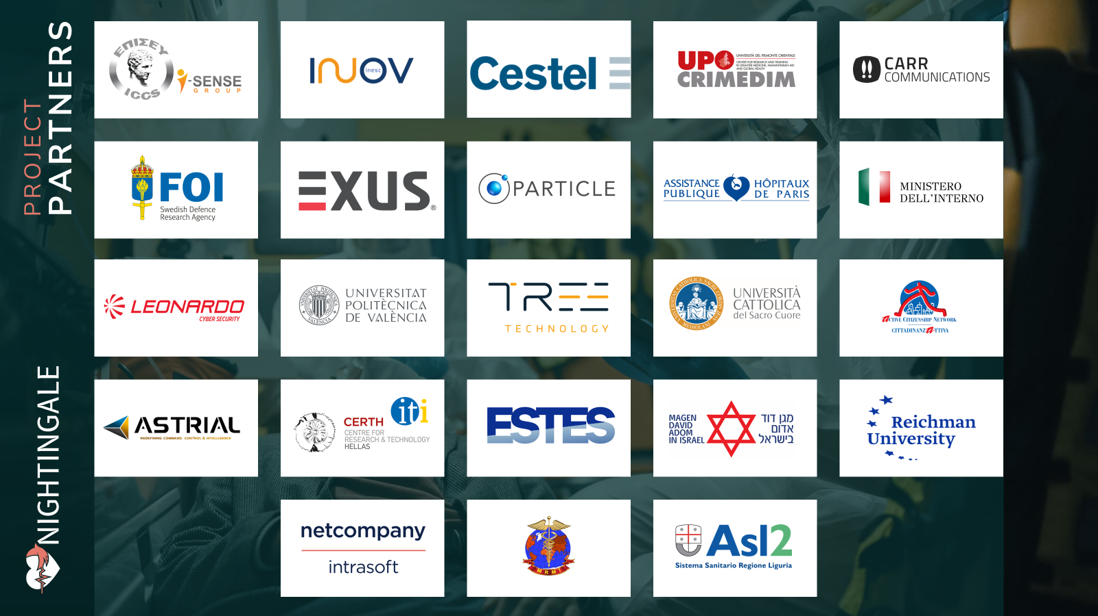
NIGHTINGALE is…
40 months European project
Started on October 1, 2021
Total budget: 8,831,477,50€
11 countries and 23 partners:
Research and Technology Organisations
Emergency medical practitioners
First responders
Specialised SMEs and industries
Notes:
Project details and parnters

Slide 4
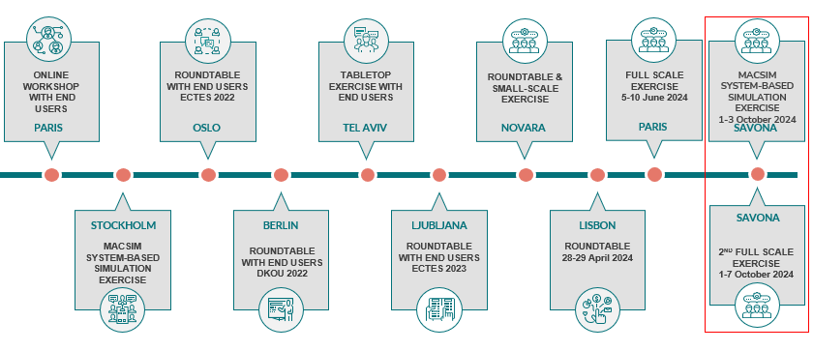
NIGHTINGALE Objectives
Optimise current procedures and methods of triage and pre-hospital life support
Enhance the operational capacities of emergency medical services in the event of mass casualty incidents
Offer intelligent, integrated, and interconnected technological solutions for emergency teams
Develop a commonly agreed operational framework for multi-agency emergency response
NIGHTINGALE Toolkit: user-centred design and validation
Notes:
Project objective achieved:
Optimise current procedures and methods of triage and pre-hospital life support
Enhance the operational capacities of emergency medical services in the event of mass casualty incidents
Offer intelligent, integrated, and interconnected technological solutions for emergency teams
Develop a commonly agreed operational framework for multi-agency emergency response
and further a figure with the:
Round tables,
Table Top eXercises (TTX)
Small Scale eXercise (SSX)
2 MACSIM system based simulation and the
2 Full Scale eXercises (FSXs)
Conducted to evaluate and finalize the technologies while validating the NIGHTINGALE toolkit.

Slide 5
NIGHTINGALE: Final Event Agenda
Time (CET) | Duration | Topic | Presenter
9:30 – 10:00 | 30’ | Login for External Users and Partners | -
10:00 – 10:05 | 5’ | Welcome and Introduction of the NIGHTINGALE Final Event | ICCS
10:05 – 10:20 | 15’ | Keynote speaker G. Skiadaresis, DRS Area Coordinator at DG HOME, European Commission | Giannis Skiadaresis
10:20 – 10:40 | 20’ | What is the NIGHTINGALE Toolkit and how it impacts the emergency medical domain? | ICCS
10:40 – 10:55 | 15’ | How could continuous monitoring of patients trigger a step-change in MCI handling? | ICCS
10:55 – 11:10 | 15’ | What AI and predictive analyses can offer to improving MCIs? | INOV
11:10 – 11:25 | 15’ | Is multi-agency collaboration a solution to limited resources and managing the chaos? | ASTRIAL
11:25 – 11:40 | 15’ | Break (15’) | -
11:40 – 12:55 | 15’ | Insights from the NIGHTINGALE First Responders | UPO
12:55 – 13:10 | 15’ | How can users effectively interpret massive monitoring and analytics data? | INTRA
13:10 – 13:25 | 15’ | NIGHTINGALE toolkit video results: Small Scale Test video (3’), 1st Full Scale Exercise video (7’) and 2nd Full Scale Exercise video (4’) | CCL
13:25 – 13:40 | 15’ | Break (15’) | -
13:40 – 13:55 | 15’ | Insights from RTC - Responder Technology Cluster of Projects, Jon Hall, Crisis Management Innovation Network Europe | Jon Hall
13:55 – 14:05 | 10’ | TEAMUP | RTC Cluster Projects
14:05 – 14:15 | 10’ | DIREKTION
14:15 – 14:25 | 10’ | OVERWATCH
14:25 – 14:35 | 10’ | CARMA
14:35 – 14:45 | 10’ | SYNERGISE
14:45 – 14:50 | 5’ | Conclusions – Future Vision | ICCS
END OF FINAL EVENT
Notes:
Besides the results of the project, it is a great pleasure for us to have with us:
Giannis Skiadaresis as a Keynote speaker from DRS Area Coordinator at DG HOME, European Commission
Jon Hall from Crisis Management Innovation Network Europe leading the cluster RTC - Responder Technology Cluster of Projects
And the projects:
TEAMUP
DIREKTION
OVERWATCH
CARMA
SYNERGISE

Slide 6
HORIZON 2020 RESEARCH PROJECT
TRIAGE
Thank You
www.nightingale-triage.eu
NIGHTINGALE Project
@NGTriageEU

